Slide 1
Thresholding on Image Segmention
Thresholding play a vary important rol in segmentation .
This makes a different between the object and background of image
It produces uniform region based on the thresold criteria ,T
Key parameter of thresholding process is the choice of threshold
Thresholding defined as .
1. Single level thresholding .
2. Multilevel thresholding.

Slide 2
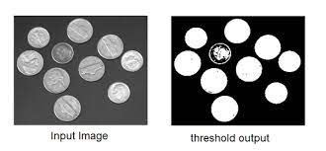

Slide 3
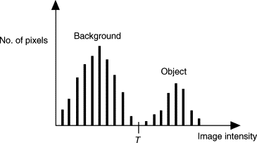
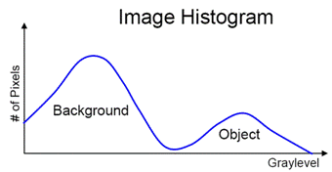

Slide 4
Single level thresholding
Suppose that an image f(x,y) , has light object an a dark background . If use draw the histogram of this type of image , it will have two dominant modes of gray level.
One group near the zero point of histogram showing dark background and one group near the maximum point showing light object
so , at he point (x,y) if
f(x,y)>T, it is called object
f(x,y)<T, it is called background
This is called single level thresholding because we have separated information of an image bt single threshold

Slide 5
Multilevel Thresholding
New , let us consider that three dominant modes characterize the image histogram for two types of light object and black background .
This is called multilevel because we have used more than one threshold for reparation of image information.

Slide 6
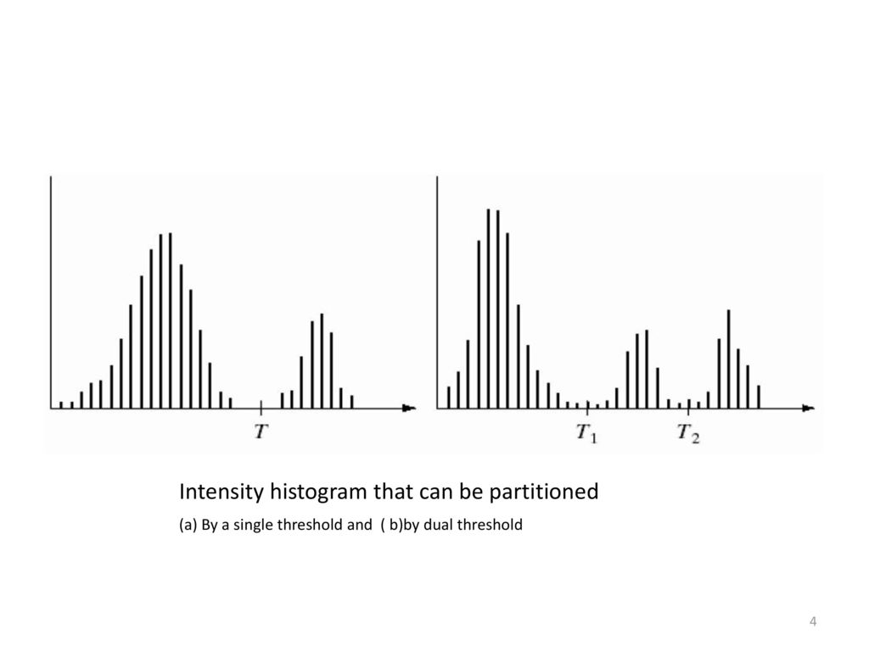

Slide 7
Types of Thresholding
Global Thresholding :- if thresholding (th) depends upon only the gray level of an image .
Local thresholding :- if thresholding depends upon the gray level image and some local properties also .
Adaptive thresholding :- when threshold depend upon gray level , local properties and spatial co-ordinates of pixel . This is called dynamic threshold .

Slide 8
Why is thresholding used in image processing?
Sometimes in image processing, we need to separate an image into some regions (or their contours), the process is called segmentation.
the natural way to segment such regions is thresholding. which is nothing but separation of dark and light regions.

Slide 9
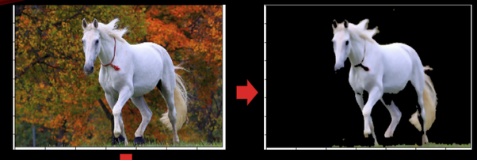
Global Thresholding :-
Global thresholding means a single value of pixel intensity threshold is used for all pixels in the images for conversing it to binary image.
Any pixel value below the threshold is given a zero value( or a 255 depending on your application).
The Threshold is global in the sense that the same threshold is applied to all pixels.

Slide 10
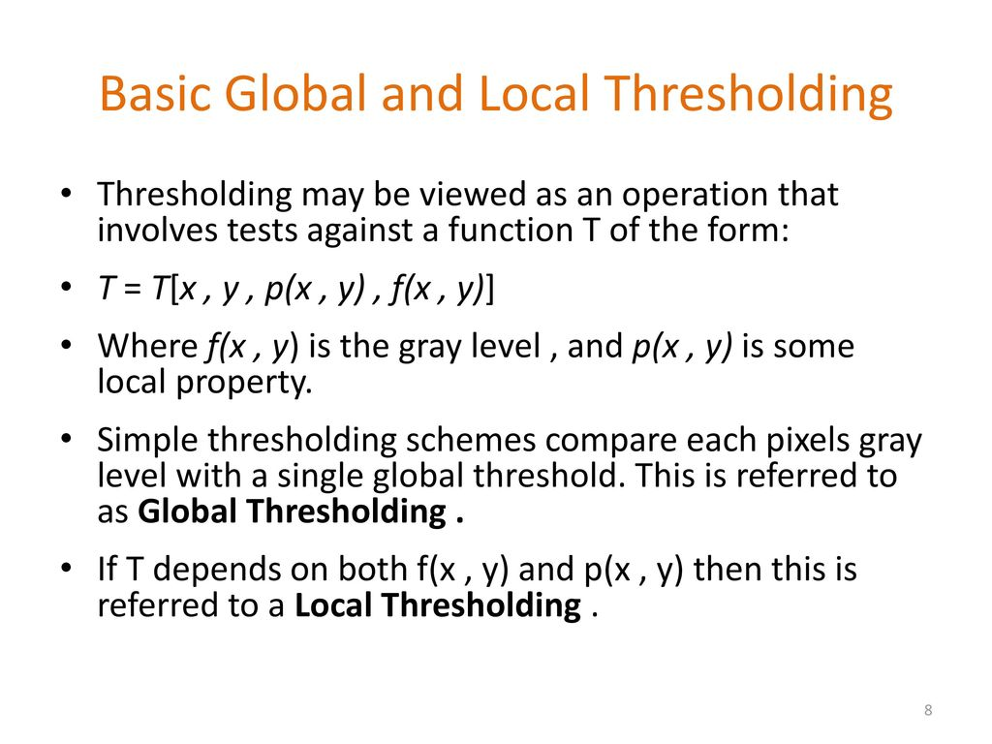

Slide 11
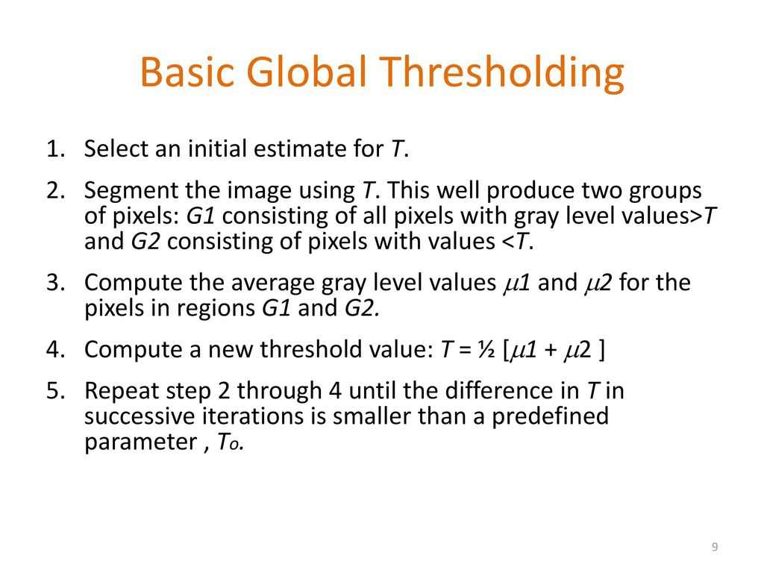

Slide 12
Adaptive Thresholding
Determines the thresholding for a pixel based on a small around it.
Different threshold for different region of the same image .
Adaptive thresholding is the method where the threshold value is calculated for smaller regions and therefore, there will be different threshold values for different regions.

Slide 13
